Slide 1
A MODERN APPROACH TO RATION DISTRIBUTION

Slide 2
Introduction to proposed system
Admin uploads the data directly to the server, verifying the data and stores the data.
It provides a queue free environment to the customer.
It is very helpful to all ration card holders, and provides services like information of current stock, view stock, checking availability of product.
When the product is added to the cart the price will vary depending on the colour of the ration card.
The admin can maintain records easily and provides payment reports.
The customers can book slots to different ration shops in order to collect the ration items from the shops with ease.

Slide 3
Objectives
The main objectives of this project are:
Ease of acquiring items.
Better knowledge on availability of items.
Customers can reserve the items in advance.
Queue free procurement of items.
Customers are able to provide complaints.

Slide 4
Scope
This project aims to do the following things:
User registration and authentication
Will show the shop opening and closing details.
Allotting time to visit the ration shop for collecting ordered products.
Complaint forum for complaint by users.
Customer can view the details about products such as name, price and availability of products.

Slide 5
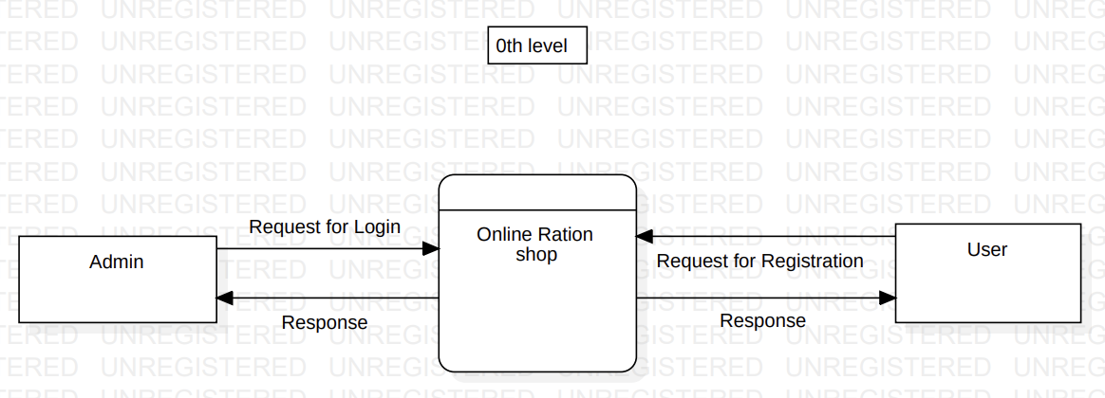
DFD (0th LEVEL)

Slide 6
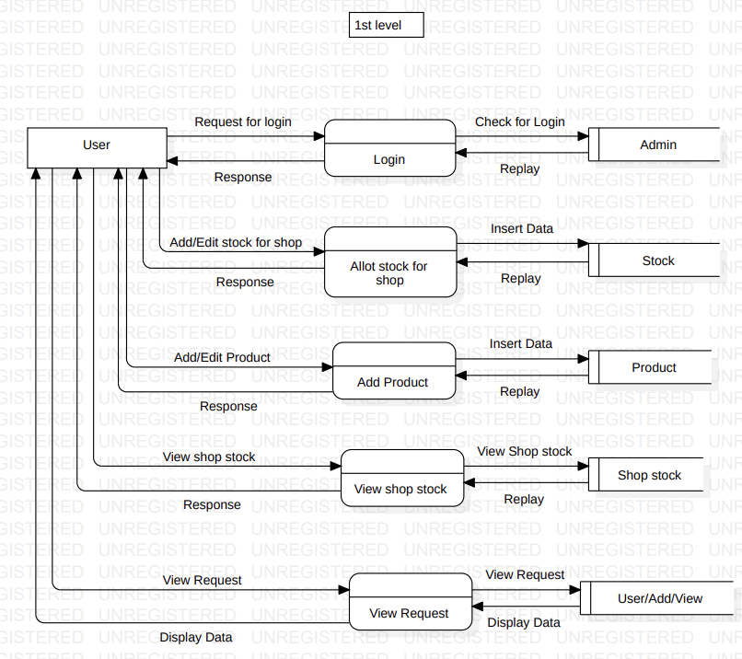
DFD (1st LEVEL)

Slide 7
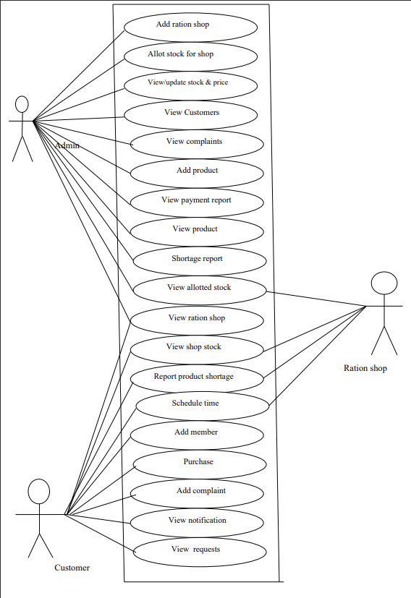
Use Case Diagram

Slide 8
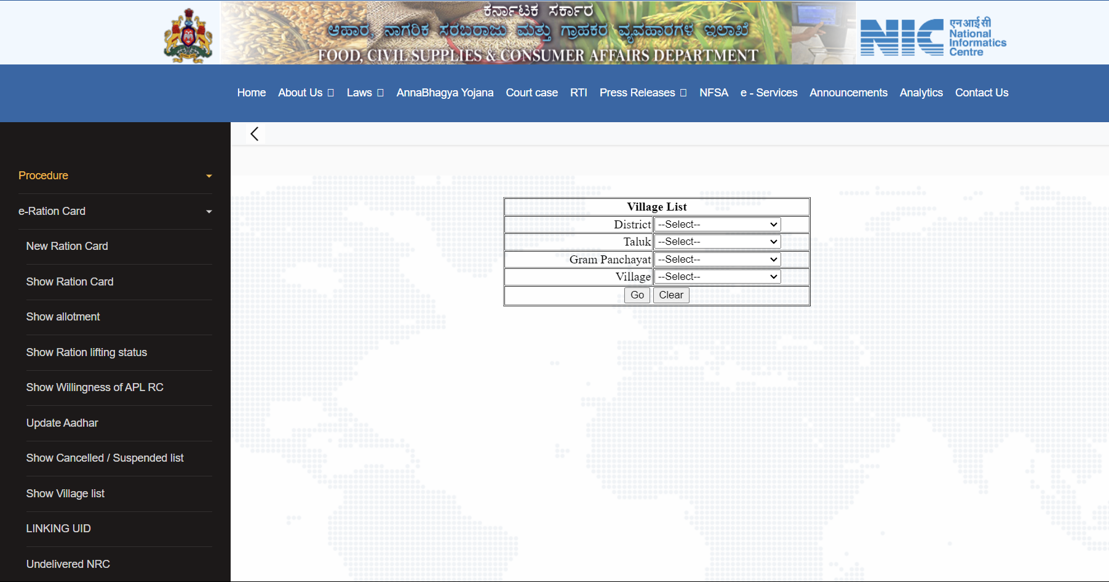
Existing System

Slide 9
Existing System VS Proposed System
Existing System | Proposed System
If a person goes to a ration shop for buying any grains he has to wait in queue till his chance comes. | In this system the person can book products online and avoid the hassle of waiting in queues.
In existing system there is only a system to check ration product and stock maintenance. | This system will have options to book for direct collection of items etc.
The existing system requires maintenance persons to maintain record, stock details etc. | The proposed system has no person keeping track of items physically.
In existing system the consumer is unable to provide their complaint and feedback. | Customers can provide complaint regarding the products through the proposed system.

Slide 10
Novelty
In this system the customers can book the products online in advance.
Customers can provide complaints and feedback regarding the products.
The system provides services like information of current stock status, report for product shortages, view product payment report etc.

Slide 11
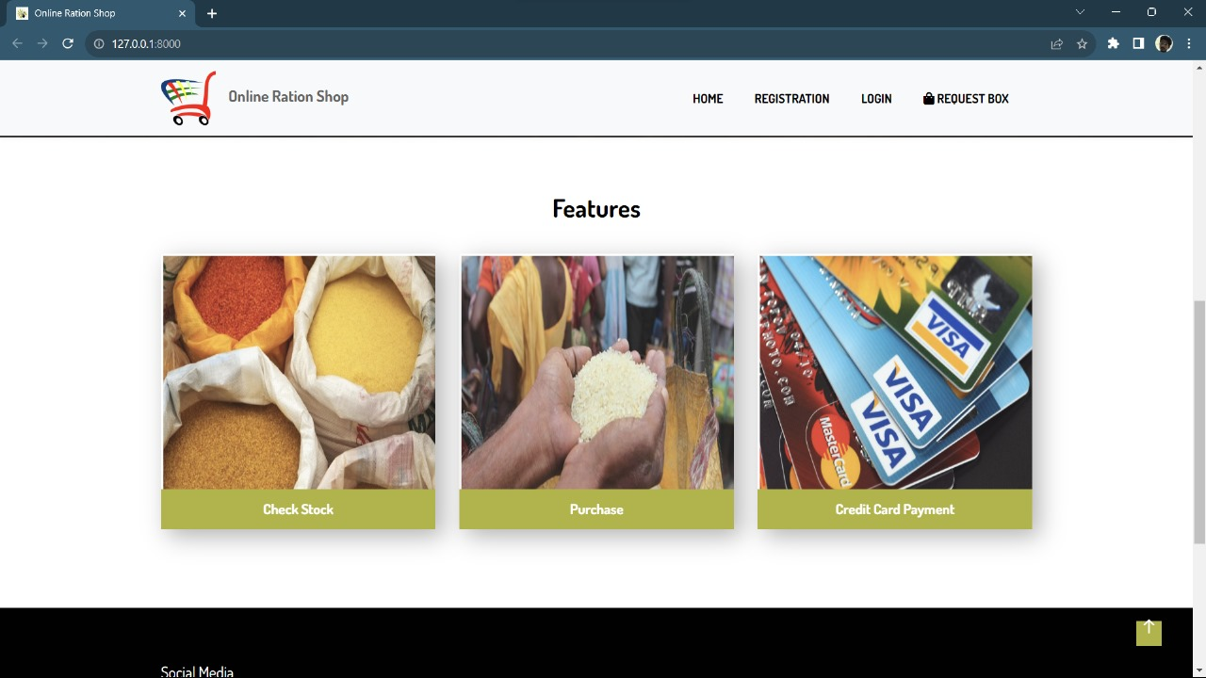
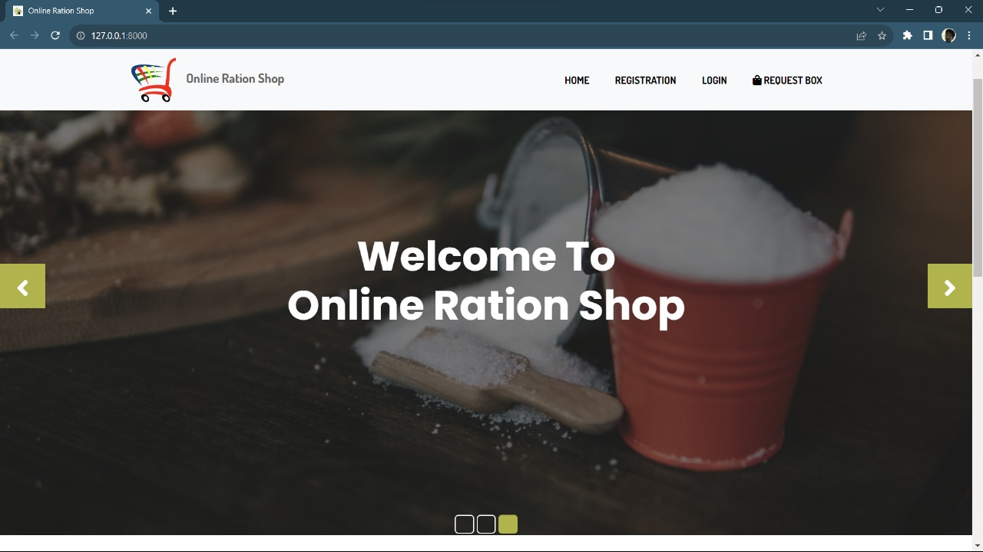
Implementation Screenshot

Slide 12
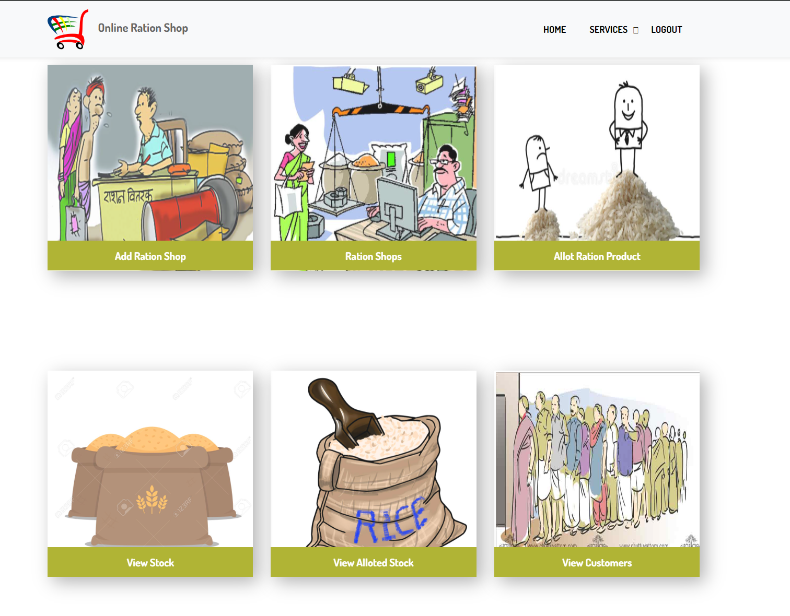
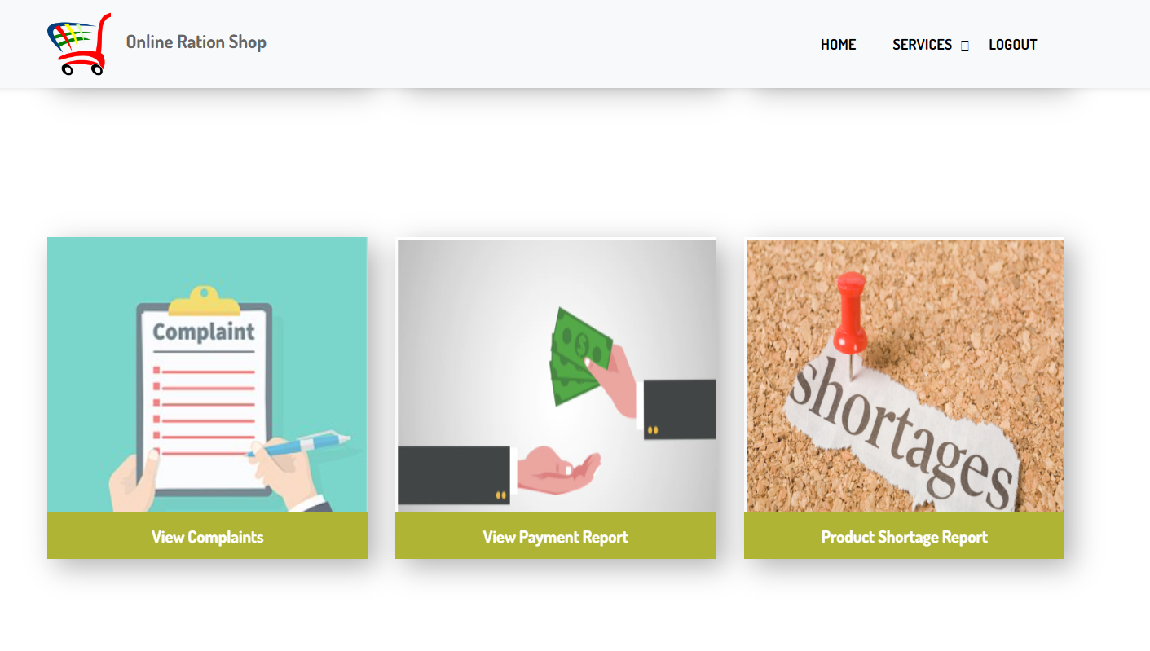
Admin

Slide 13
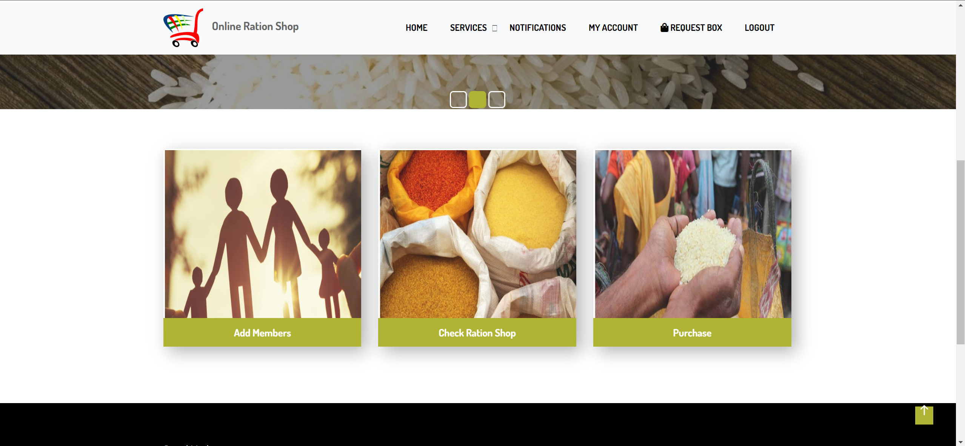
Customer

Slide 14
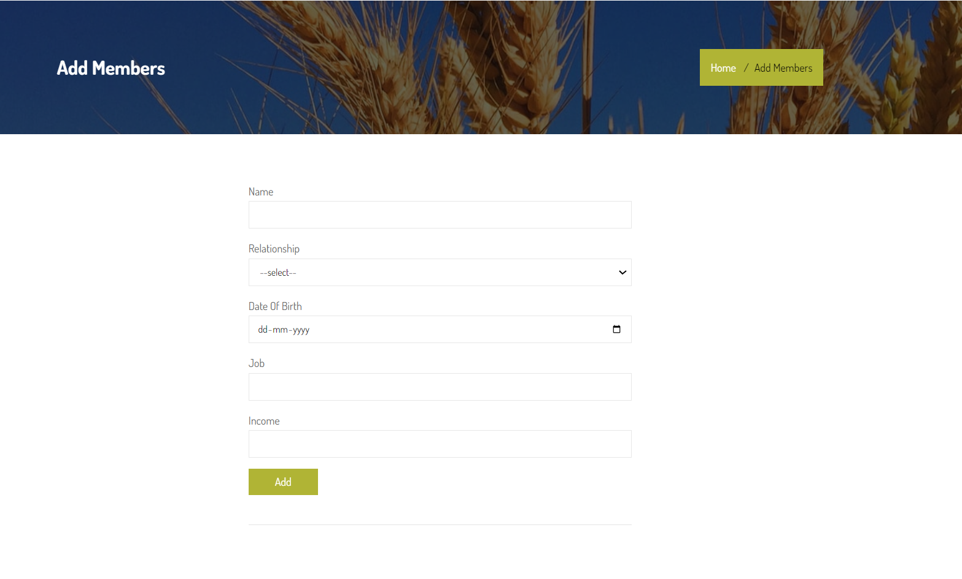
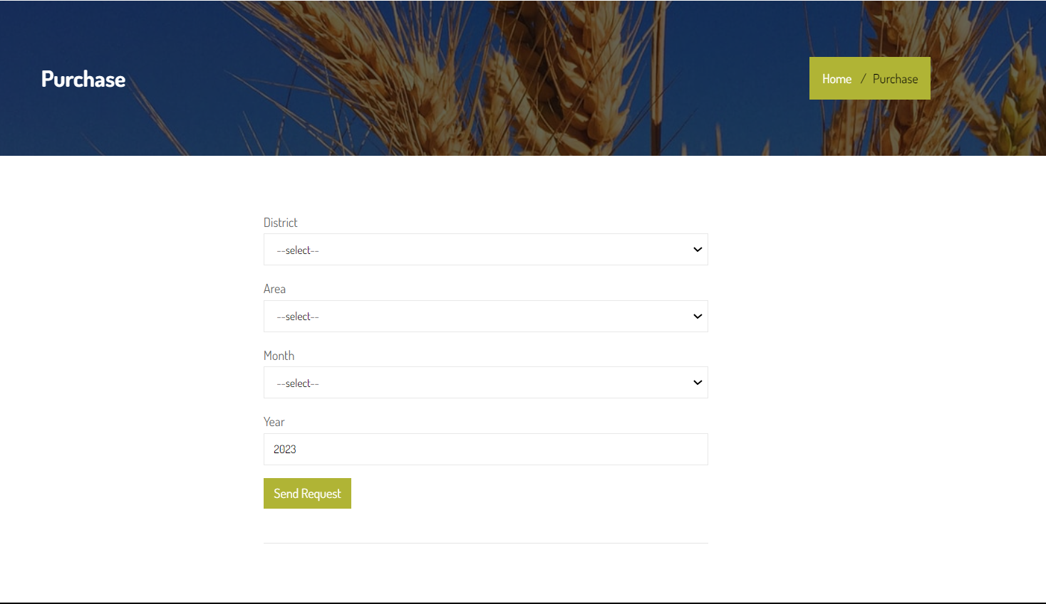
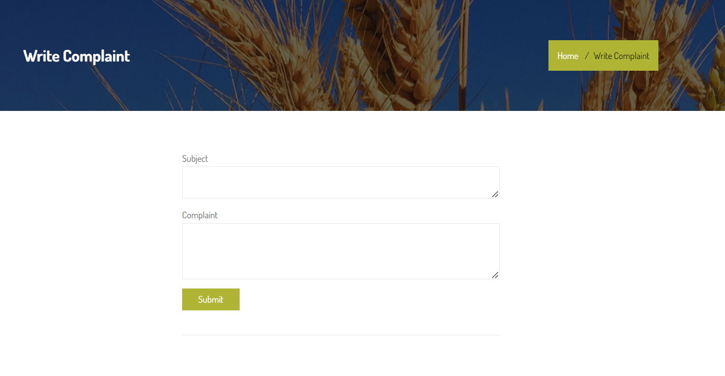

Slide 15
References
https://ahara.kar.nic.in/
https://cleartax.in/s/ration-cards-types-benefits

Slide 16
Thank You

